Slide 1

UNSUPERVISED GENERATIVE ADVERSARIAL NETWORKS USING DEEP CONVOLUTIONAL
Group Name: Data Mining Redhawks
Group Members:
Mohammed Nurul Abedin Ashraf
Sheshanth Reddy Ananthula
Krishna Sai Bezavada
Saikrishna Karnati
Sindhu Mandalapu
GitHub Link:
https://github.com/abedin-ashraf/DCGAN-CS505-

Slide 2

Table of Content:
Abstract
Introduction
Tools & Programming Languages used
Related Work
Program Parameters
Hardware & Software used (Materials and Methods)
Results and Discussion
Future Works
Conclusions
References

Slide 3
1. ABSTRACT
In this project, we have the idea to use the unsupervised model technique to replicate the images in a different approach using the GENERATIVE ADVERSARIAL NETWORKS.
We are doing this approach using the tool tensor flow technique as it increased the efficiency for this unsupervised approach model to get exact results of this model.

Slide 4
2. Introduction:
We are two types of approaches first one is supervised, and the second one is an unsupervised Model.
In this project, we will use an unsupervised learning method using GENERATIVE ADVERSARIAL NETWORKS.
We introduce a deep convolutional GAN model with specific architectural constraints to strengthen unsupervised learning and we will demonstrate these features and their applicability.

Slide 5
3. Related Work
1. REPRESENTATION LEARNING FROM UNLABELED DATA:
Unsupervised representation learning has received much attention in image-specific and generic computer vision research.
A classic approach to unsupervised representation learning is to do clustering on the data (for example, using K-means) and leverage the clusters for improved classification scores.
In the context of images, one can do hierarchical clustering of image patches (Coates & Ng, 2012) to learn powerful image representations

Slide 6
3. Related Work
2. GENERATING NATURAL IMAGES:
Generative image models are well-studied and fall into parametric and nonparametric categories.
The non-parametric models often do match from a database of existing images, matching patches of images, and have been used in texture synthesis
Parametric models for generating images have been explored extensively (for example, on MNIST digits or for texture synthesis (Portilla & Simoncelli, 2000)).
Another approach generates images using an iterative forward diffusion process. Generative Adversarial Networks (Goodfellow et al., 2014) generated images suffering from being noisy and incomprehensible.
A laplacian pyramid extension to this approach(Denton et al., 2015) showed higher quality images3.

Slide 7
3. Related Work
3. VISUALIZING THE INTERNALS OF CNNS:
One constant criticism of using neural networks has been that they are black-box methods, with little understanding of what the networks do in the form of a simple human-consumable algorithm.
In the context of CNNs, Zeiler et. al. (Zeiler & Fergus, 2014) showed that by using deconvolutions and filtering the maximal activations, one can find the approximate purpose of each convolution filter in the network

Slide 8
4. Program Parameters
Mini-batch size of 32.
Weights initialized from normal Distribution with mean=0, st. dev = 0.2
LeakyReLU, Alpha =0.2
Adam optimizer with Hyperparameter Tuning
Leaning rate = 0.0001
latent_dim for generator = 128

Slide 9
5. Hardware & Software used:
Hardware Specifications:
Processor: Ryzen 5800H, GPU-RTX 3060M, 16GB
Language: Python 3.9.13
Tools: Anaconda software, Jupyter Notebook Software, Tensor flow
Other Software: Nvidia Cuda and Nvidia Tensor (to enable GPU)

Slide 10
6. Results and Discussion:
As we ran the unsupervised model using the GENERATIVE ADVERSARIAL NETWORKS method, we got the accurate output for the unsupervised model.
We have only a few amounts of limitations. We run only 20 epoch, and we don’t have time for all the epoch.
If we run the approach 100 times later than 20 times, we will get the exact fake images generated by the GENERATIVE ADVERSARIAL NETWORKS.
We can see the sample input and output images in the next slides.

Slide 11
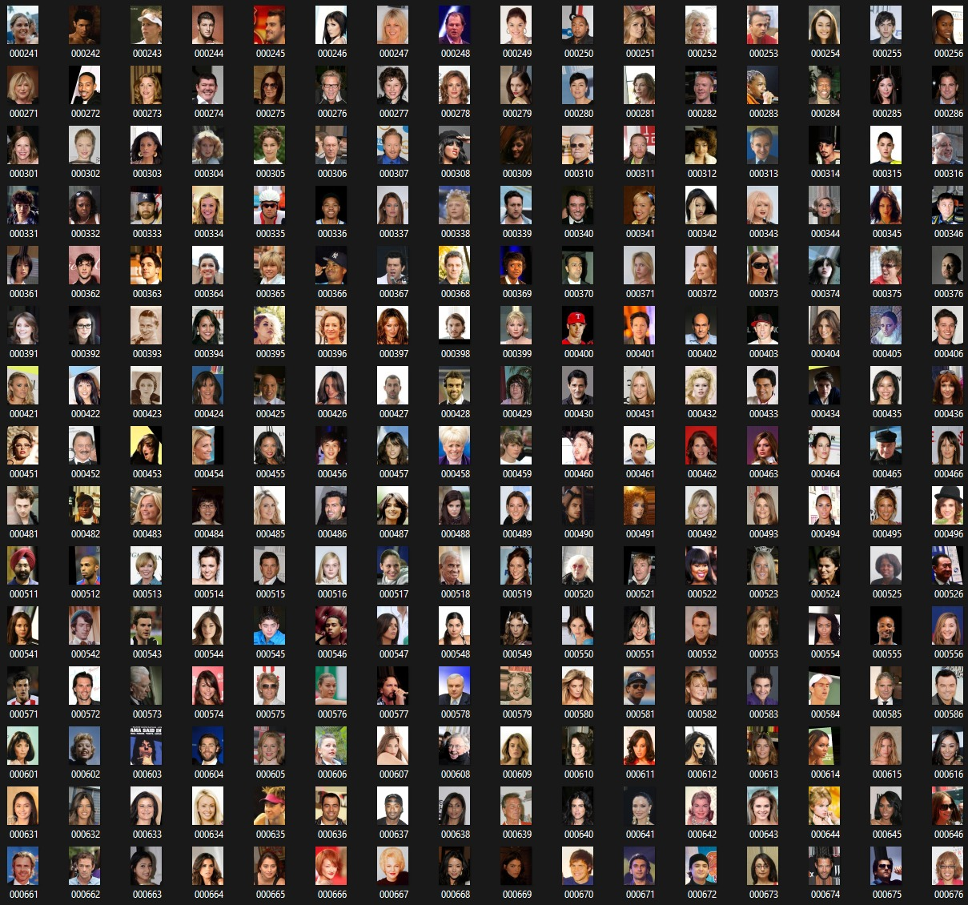
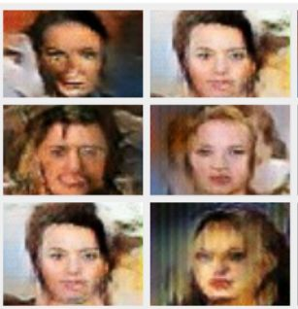
7. Results and Discussion
INPUT IMAGES
OUTPUT IMAGES

Slide 12
8. FUTURE WORKS:
Progressive Growing GAN, also known as ProGAN, is an extension of the GAN training procedure that enables the generator models to train steadily and produce huge, high-quality images. It was developed by Tero Karras, Timo Aila, Samuli Laine, and Jaakko Lehtinen of NVIDIA.
It entails training by beginning with a small image and adding blocks of layers incrementally so that the generator model's output size and the discriminator model's input size increase until the required image size is attained. This kind of strategy has shown to be quite effective at producing realistic synthetic images of the highest quality.

Slide 13
9. CONCLUSIONS:
In Future work, we can consider more effective system configuration tools so we will not worry the how many approaches we run on the system
The system took a little bit longer to run all the approaches. If we use a more effective interface processor, we can generate an output of it
As of now, we are generating only 20 approaches; if we have a more effective system. we can run 100 approaches to get exact images of the unsupervised model images.

Slide 14
10. REFERENCES
Bergstra, James and Bengio, Yoshua. Random search for hyper-parameter optimization. JMLR, 2012.
Coates, Adam and Ng, Andrew. Selecting receptive fields in deep networks. NIPS, 2011.
Coates, Adam and Ng, Andrew Y. Learning feature representations with k-means. In Neural Networks: Tricks of the Trade, pp. 561–580. Springer, 2012.
Deng, Jia, Dong, Wei, Socher, Richard, Li, Li-Jia, Li, Kai, and Fei-Fei, Li. Imagenet: A large-scale hierarchical image database. In Computer Vision and Pattern Recognition, 2009. CVPR 2009. IEEE Conference on, pp. 248–255. IEEE, 2009.

Slide 15
Thank You

